Slide 1


IoT on premises
How to start an adventure with
&
Mariusz Krzanowski

Slide 2
Goals of the presentation
Primary goals
Secondary Goals
How to begin an adventure with IoT?
What is the minimum set of devices needed to start the fun?
Where are the limitations of current IoT devices?
Extend our current architectural knowledge, by reviewing new solutions.
Familiarizing with other approaches of solving problems.

Slide 3


About ME
Employed in IT since 1999
Developer / Architect / Team Leader
Now: Senior Software Developer @ Demant Technology Centre
Experienced in many technologies
.NET, SQL, SharePoint, BizTalk, Google Cloud, Android, SCCM Active Directory, Web Development … 20 years is long time ☺
I like to share my knowledge with others – you can meet me at Warszawska Grupa .NET (WG-NET)

Slide 4
Agenda:
What devices will be presented today?
What is Node-Red?
Workflow engine
What do we have out of the box
Key components
What is Mosquitto?
MQTT
Message Broker
Key components
How to start an adventure with Workflow Engine and MQTT
A lot of practical examples!
☺

Slide 5
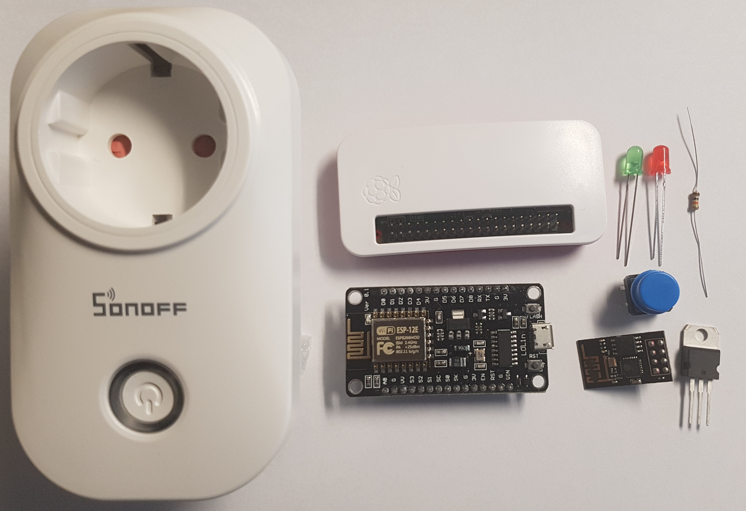
Featured devices
WI-FI Router (out of scope)
Raspberry PI Zero W (€12-€17)
ESP8266-12E board (~€6)
ESP8266-01 (~€3)
SONOFF S20 (~17€)
Diodes, thermometers, transistors, resistors, toggle switches … (~€0.1 each)
Various power supplies
Bonus ☺

Slide 6
What is Node-Red?
Developed originally by IBM as a flow design tool.
Web browser based application. Server side written in NodeJS.
Dashboard delivers: buttons, gauges and charts.
It is open-source since September 2013.
Multiple out of the box nodes - including MQTT.
JavaScript based functions.
NOTE: Preinstalled on Raspberry PI – update suggested.
https://nodered.org/

Slide 7
FYI: How to INSTALL Node-Red
sudo apt-get upate
sudo apt-get upgrade
sudo apt-get install nodered
sudo systemctl enable nodered.service
NOTE: from UI install: node-red-dashboard

Slide 8
DEMO (1) Node-Red
3 types of nodes
Input
Output
Transform
Inject Node
Debug Node

Slide 9
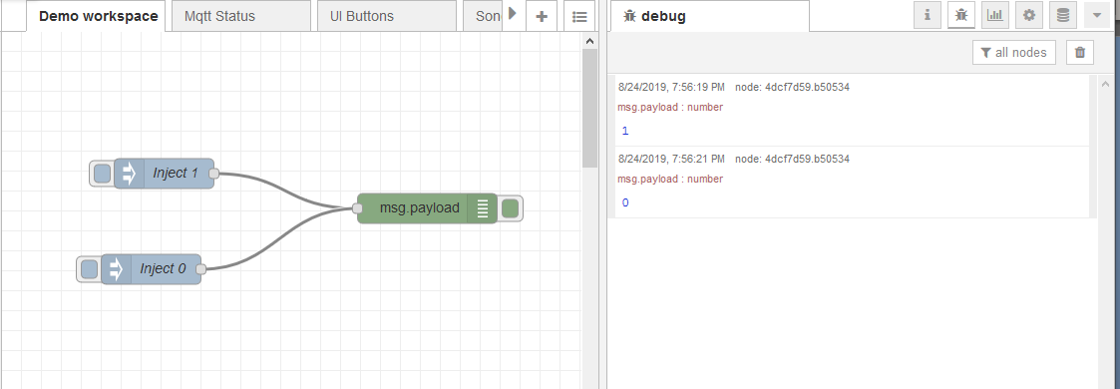
DEMO (1) Node-Red – first flow

Slide 10
DEMO (1) Node-Red – First flow
DEMO TIME ☺
http://192.169.168.10:1880/

Slide 11
DEMO (2) Raspberry PI and DIODE

Slide 12
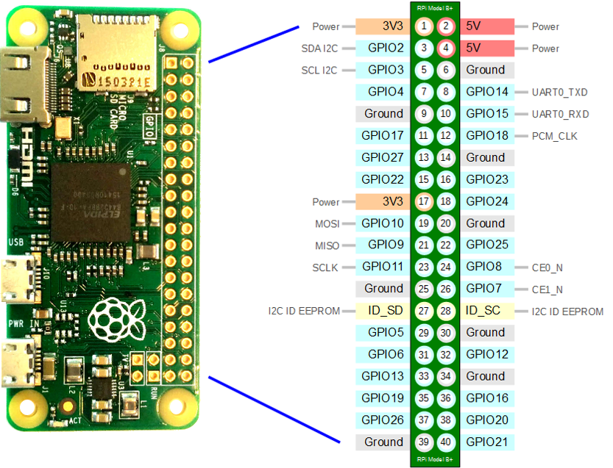
DEMO (2) - Raspberry PI W – pinout
https://raspberrypi.stackexchange.com/questions/83610/gpio-pinout-orientation-raspberypi-zero-w

Slide 13
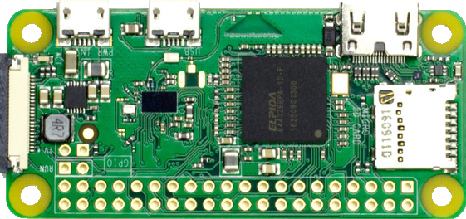
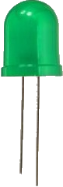
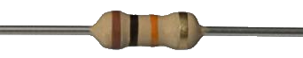
DEMO (2) Circuit schema
Longer leg is a positive electrode (+)
3.3 KΩ
GND
GPIO21

Slide 14
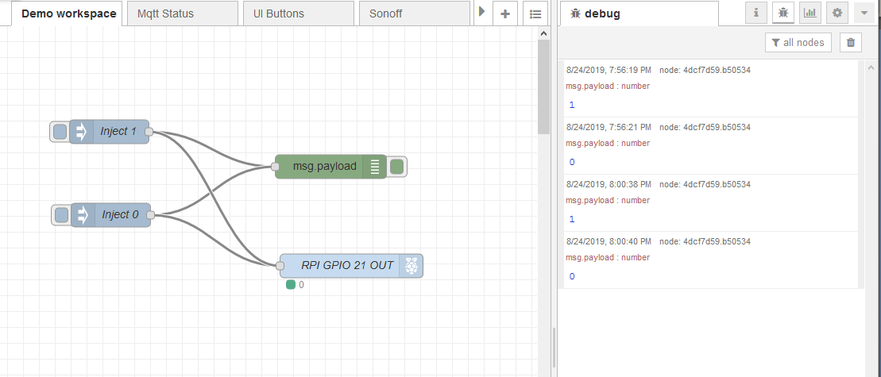
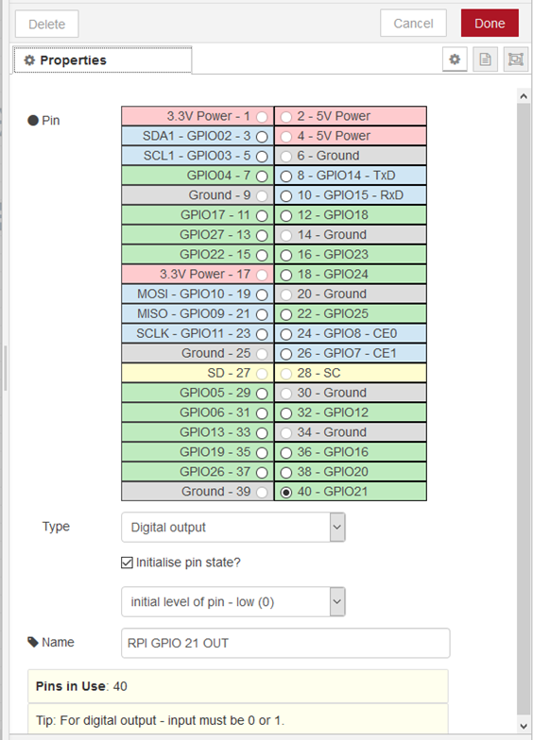
DEMO (2) Raspberry PI and DIODE

Slide 15
DEMO (2) Raspberry PI and DIODE

Slide 16
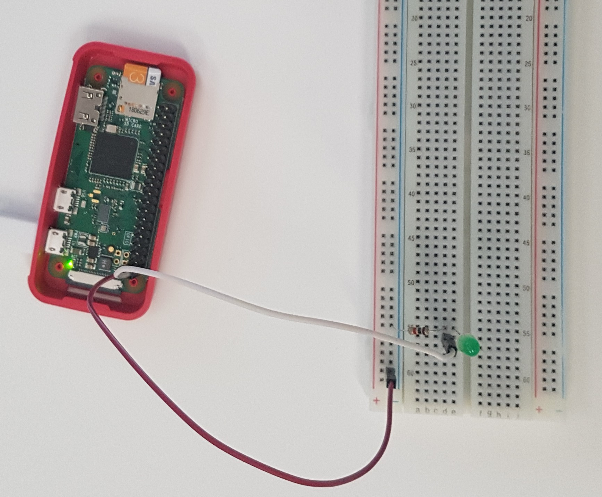
DEMO (2) - breadboard Photo
DEMO TIME ☺

Slide 17
What is Mosquitto™
Message broker that implements MQTT protocol.
MQTT stands for Message Queuing Telemetry Transport.
NOTE: Available on Raspberry PI.
Created by Roger Light in 2009.
https://mosquitto.org/
NOTE! MQTT protocol is used e.g. by:
Facebook Messenger
Microsoft Azure IoT Hub
Amazon Web Services

Slide 18
MQTT Broker architecture
Publisher 1
Subscriber 1
Publisher 2
Subscriber 2
.
.
.
.
.
.
.
.
.
.
.
.
Publisher N
Communication process is asynchronous.
Publisher does not ‘know’ any subscribers.
Subscriber N

Slide 19
MQTT – Domain language
Payload – array of bytes by default. Strings or JSON is used for better readability.
Topic – Like URI determines a category to which a message belongs. NOTE! Topics are case sensitive!
Topic examples:
/lamp/kitchen/status
/lamp/kitchen/command
/heater/dining-room/temperature
Publisher can publish messages for predefined topic.
Subscriber can subscribe for messages under specified topics.
Wildcards help to subscribe to multiple topics:
# can be used as a wildcard for all remaining levels of hierarchy e.g. /lamp/#
+ can be used as a wildcard for a single level of hierarchy e.g. /+/kitchen/+

Slide 20
FYI: How to INSTAL Mosquitto?
sudo apt-get upate
sudo apt-get upgrade
sudo apt-get install mosquitto
sudo apt-get install mosquitto-clients
sudo mosquitto_passwd -c /etc/mosquitto/passwd IotUserMqtt
sudo systemctl enable mosquitto

Slide 21
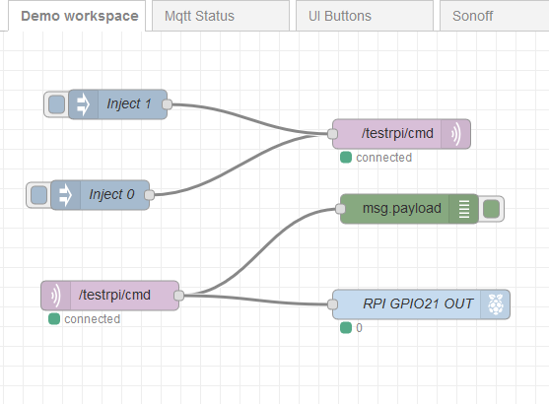
Demo(3) – MQTT on node red only
DEMO TIME

Slide 22

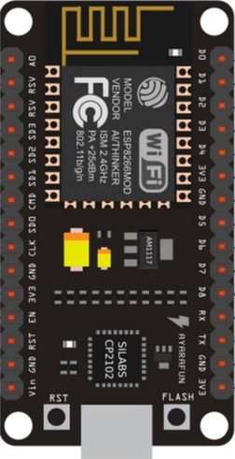
Demo (4) – MQTT ON ESP8266-E12
WI-FI Router
MQTT Client
MQTT Broker

Slide 23
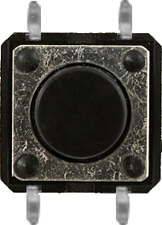
Demo (4) – MQTT ON ESP8266-E12
3.3 KΩ
D1
D3
GND
3.3 V
10KΩ

Slide 24
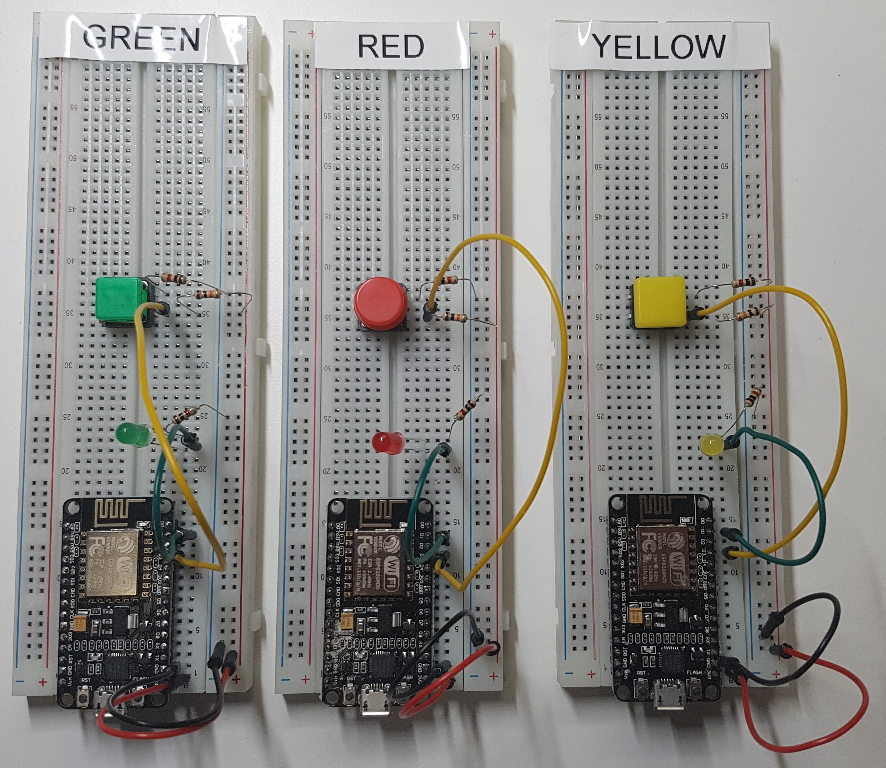
Demo (4) – MQTT ON ESP8266-E12

Slide 25
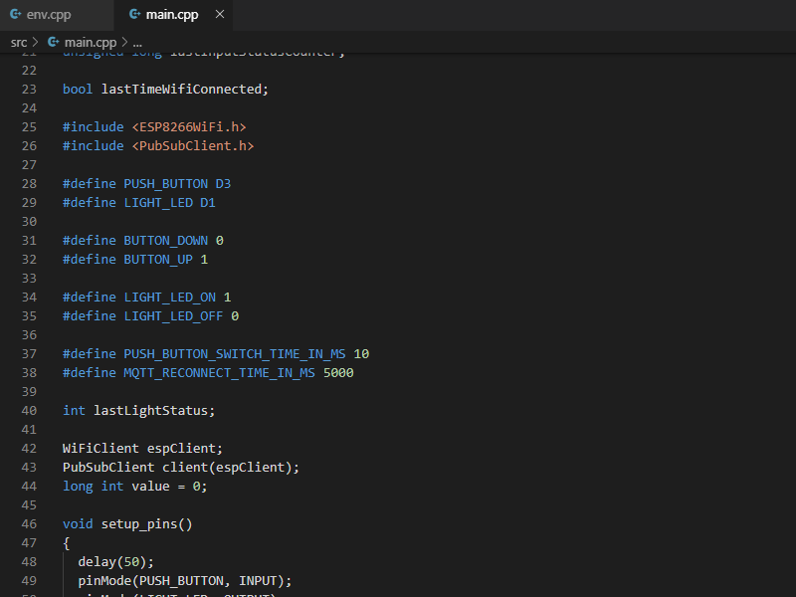
Demo (4) – MQTT ON ESP8266-E12
Source code:
src\Arduino\DiodeAndButton

Slide 26
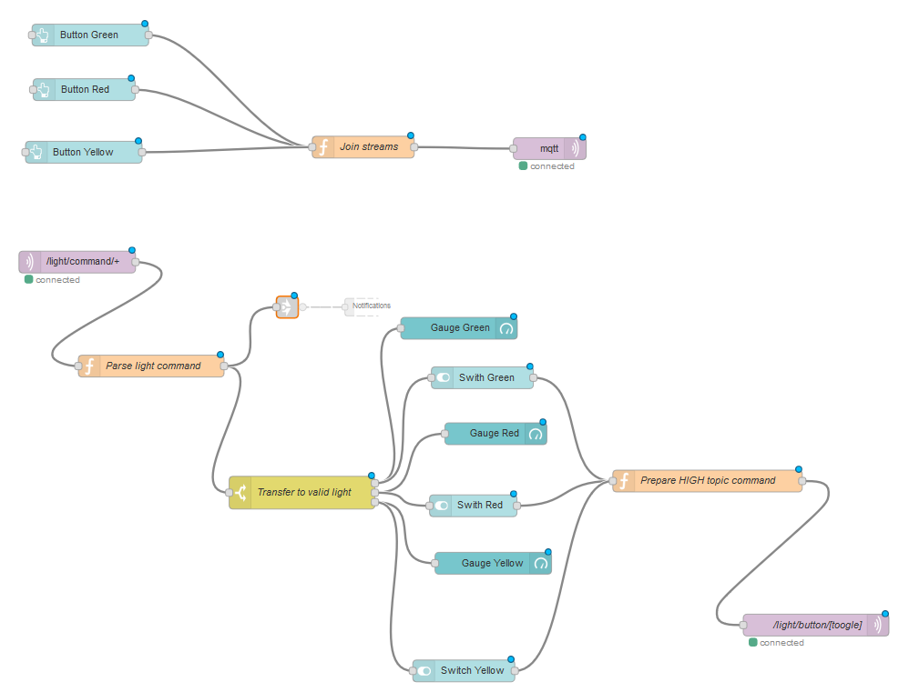
Demo (4) – MQTT ON ESP8266-E12

Slide 27
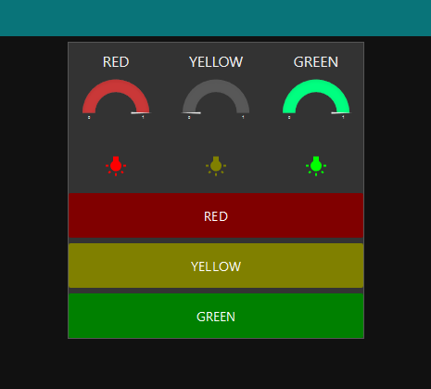
Demo (4) – MQTT ON ESP8266-E12
DEMO TIME

Slide 28
Quiz
Question:
How many wires does 1-Wire Protocol use? NOTE. It is a tricky question.

Slide 29
Quiz
Question:
How many wires does 1-Wire Protocol use? NOTE. It is a tricky question.
Answer:
3 wires in normal mode: VCC, DATA, GND
2 wires in parasite mode: VCC – DATA, GND

Slide 30
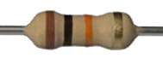
1-Wire protocol (Parasite mode)
This ‘single’ wire allows you to connect multiple devices to a single controller.
VCC
DATA
S1
S2
SN
GND
Slave node
Slave node
Slave node
Master node

Slide 31
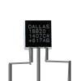
Demo (5) – Thermometer
3.3 KΩ
D1
D3
DS18B20
D7
GND
3 V
2 x 1KΩ
10KΩ

Slide 32
Demo (5) – Thermometer
3.3 KΩ
D1
D3
DS18B20
D7
GND
3 V
2 x 1KΩ
10KΩ

Slide 33
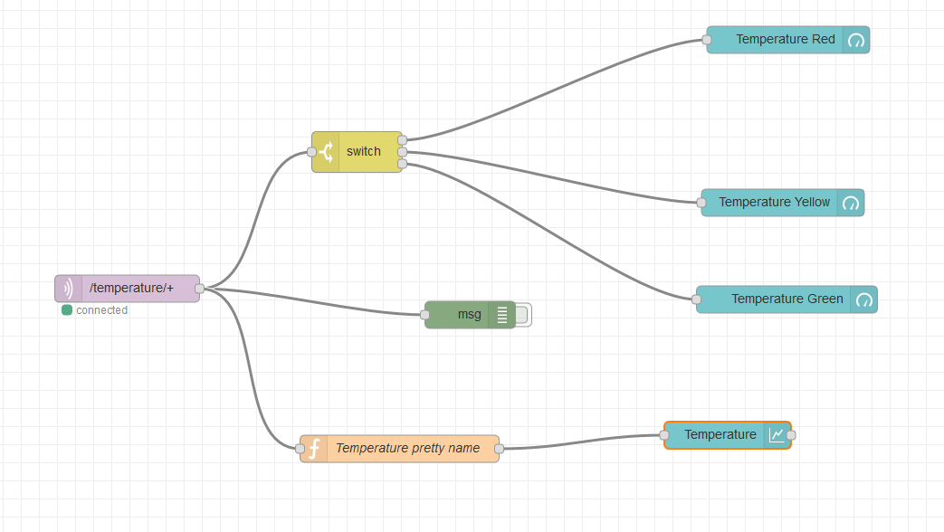
Demo(5) Thermometer

Slide 34
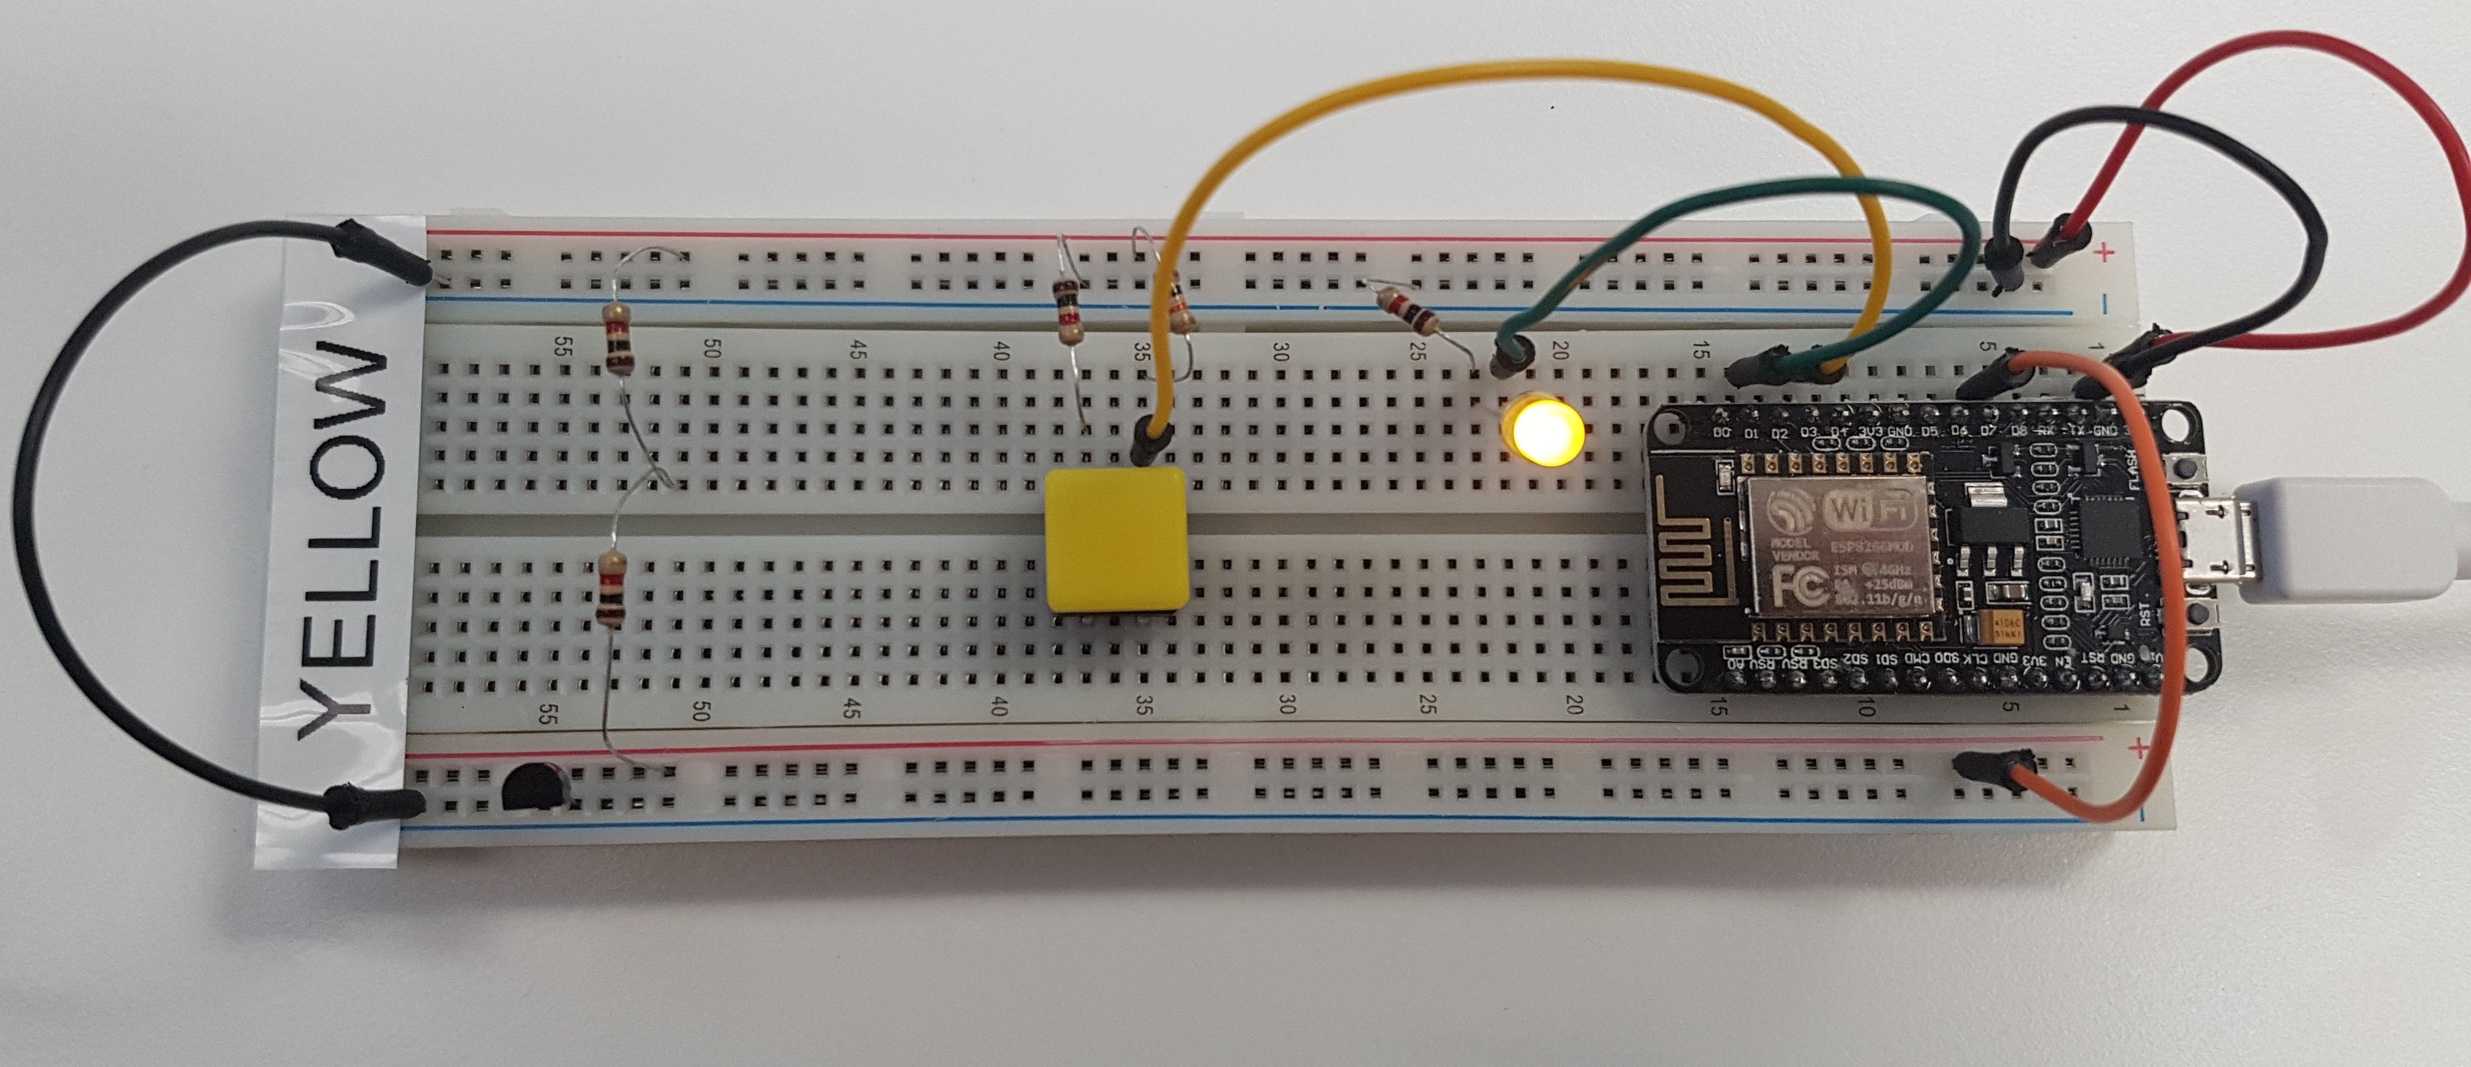
Demo(5) Thermometer
VCC
GND
Thermometer
Data Line

Slide 35
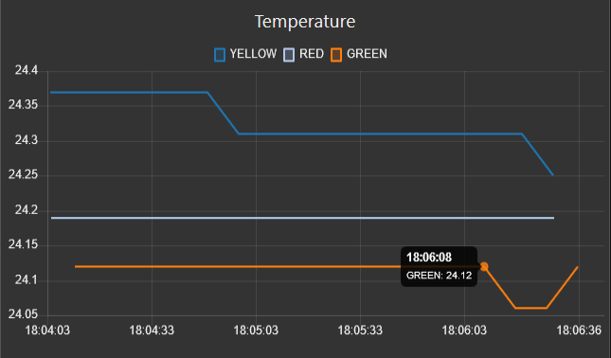
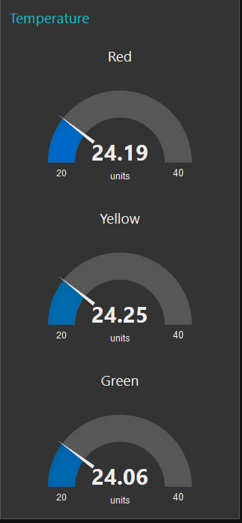
Demo(5) Thermometer
DEMO TIME

Slide 36
Sonoff S20
SONOFF is a ‘smart’ socket
It uses ESP8266-01S SoC (System on chip).
You can manage it by Android or iOS application.
You can hack it using Arduino and small hooks.

Slide 37
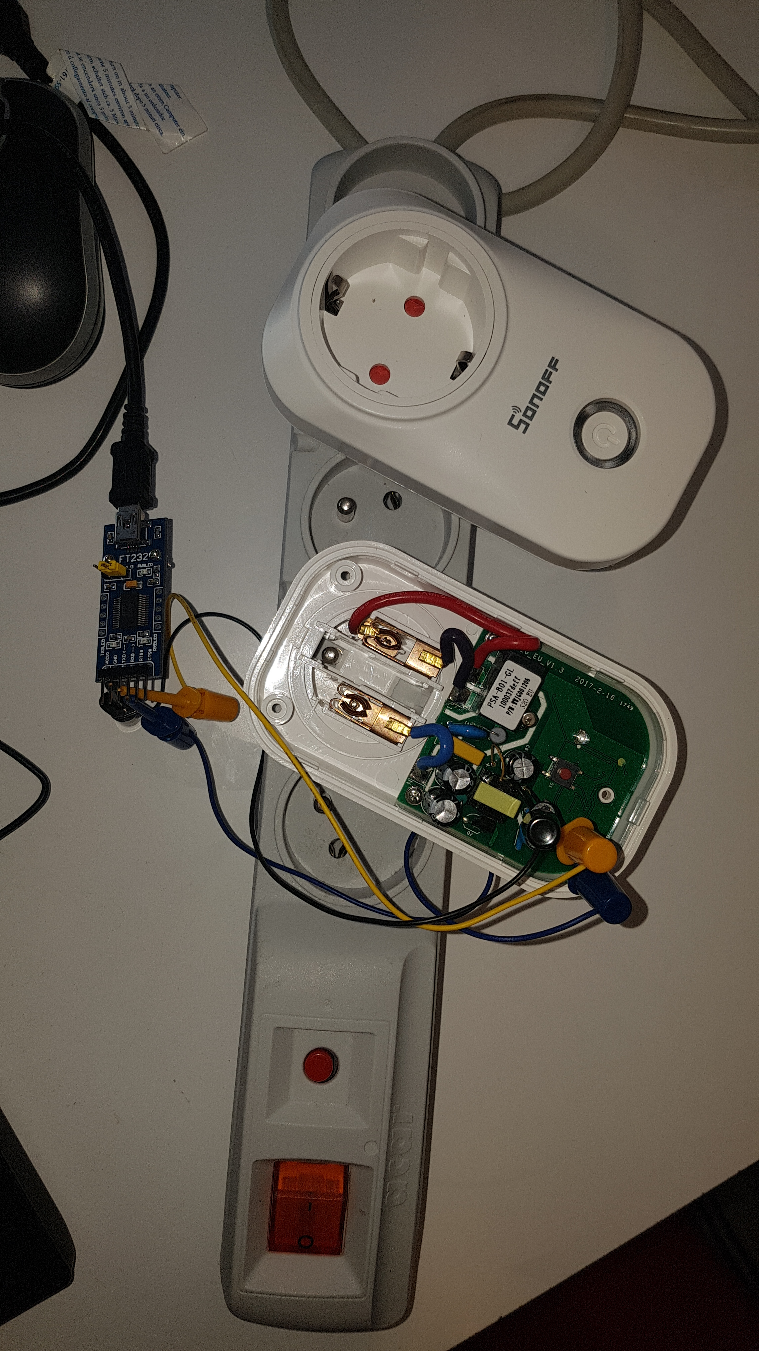
Demo(6) Sonoff S20
WARNING !!!
HIGH VOLTAGE !!!

Slide 38
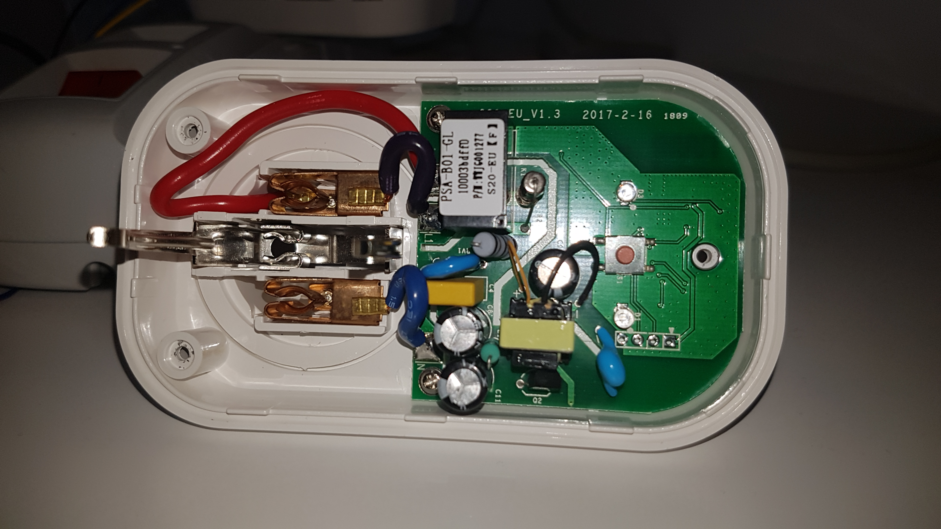
Demo(6) Sonoff S20
WARNING !!!
HIGH VOLTAGE !!!
3.3V
RX
TX
GND
GPIO 0

Slide 39
Demo(6) Sonoff S20
WARNING !!!
HIGH VOLTAGE !!!
3.3V
RX
TX
GND
GPIO 0
NOTE
You need to connect TX ⬄ RX and RX⬄ TX on your serial port adapter. ESP chipset supports only 3.3 volts. Your RS-232 adapter must support 3.3 volts on input and output ports.

Slide 40
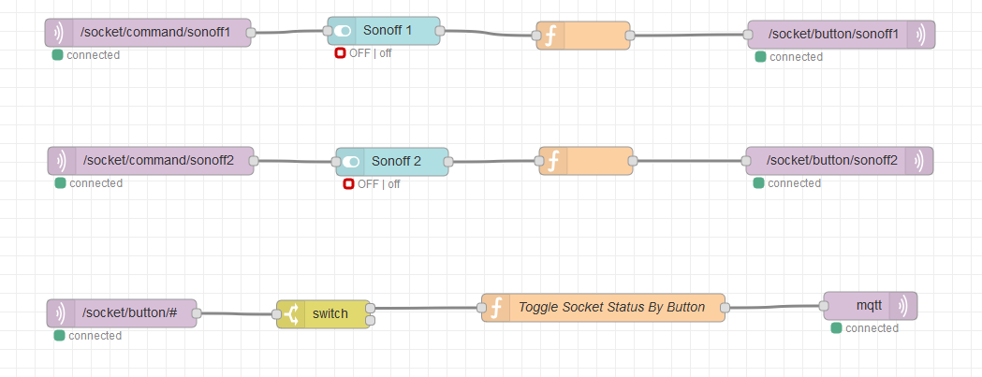
Demo(6) Sonoff S20

Slide 41
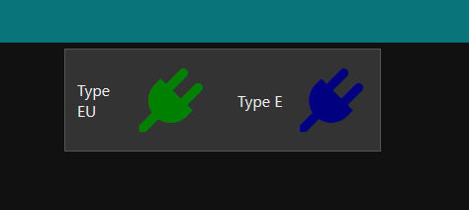
Demo(6) Sonoff S20
DEMO TIME ☺

Slide 42
BONUS (1) BLE - Intruder

Slide 43
BONUS (2) MQTT & VOICE CLIENT
Aragorn. Switch on the red light.

Slide 44
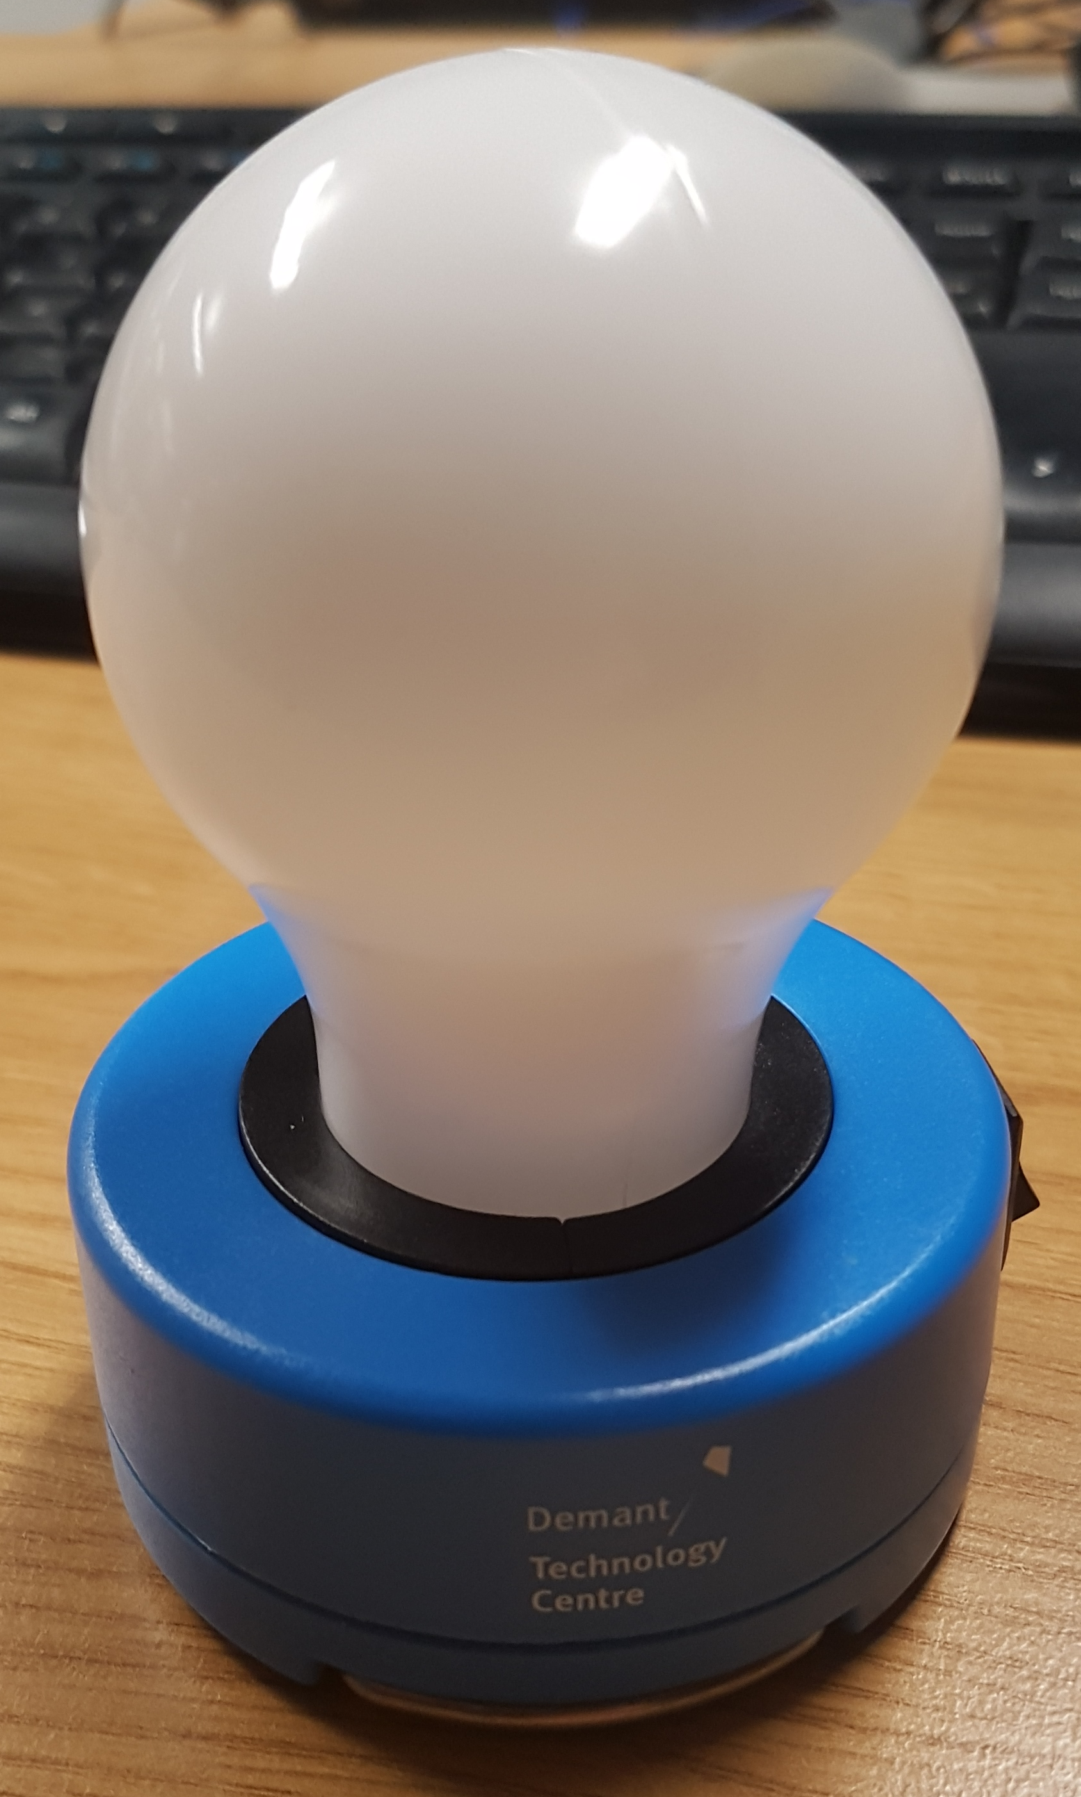
BONUS (3) Smart LAMP
What will happen when you change initial product purpose and extend its usability?

Slide 45
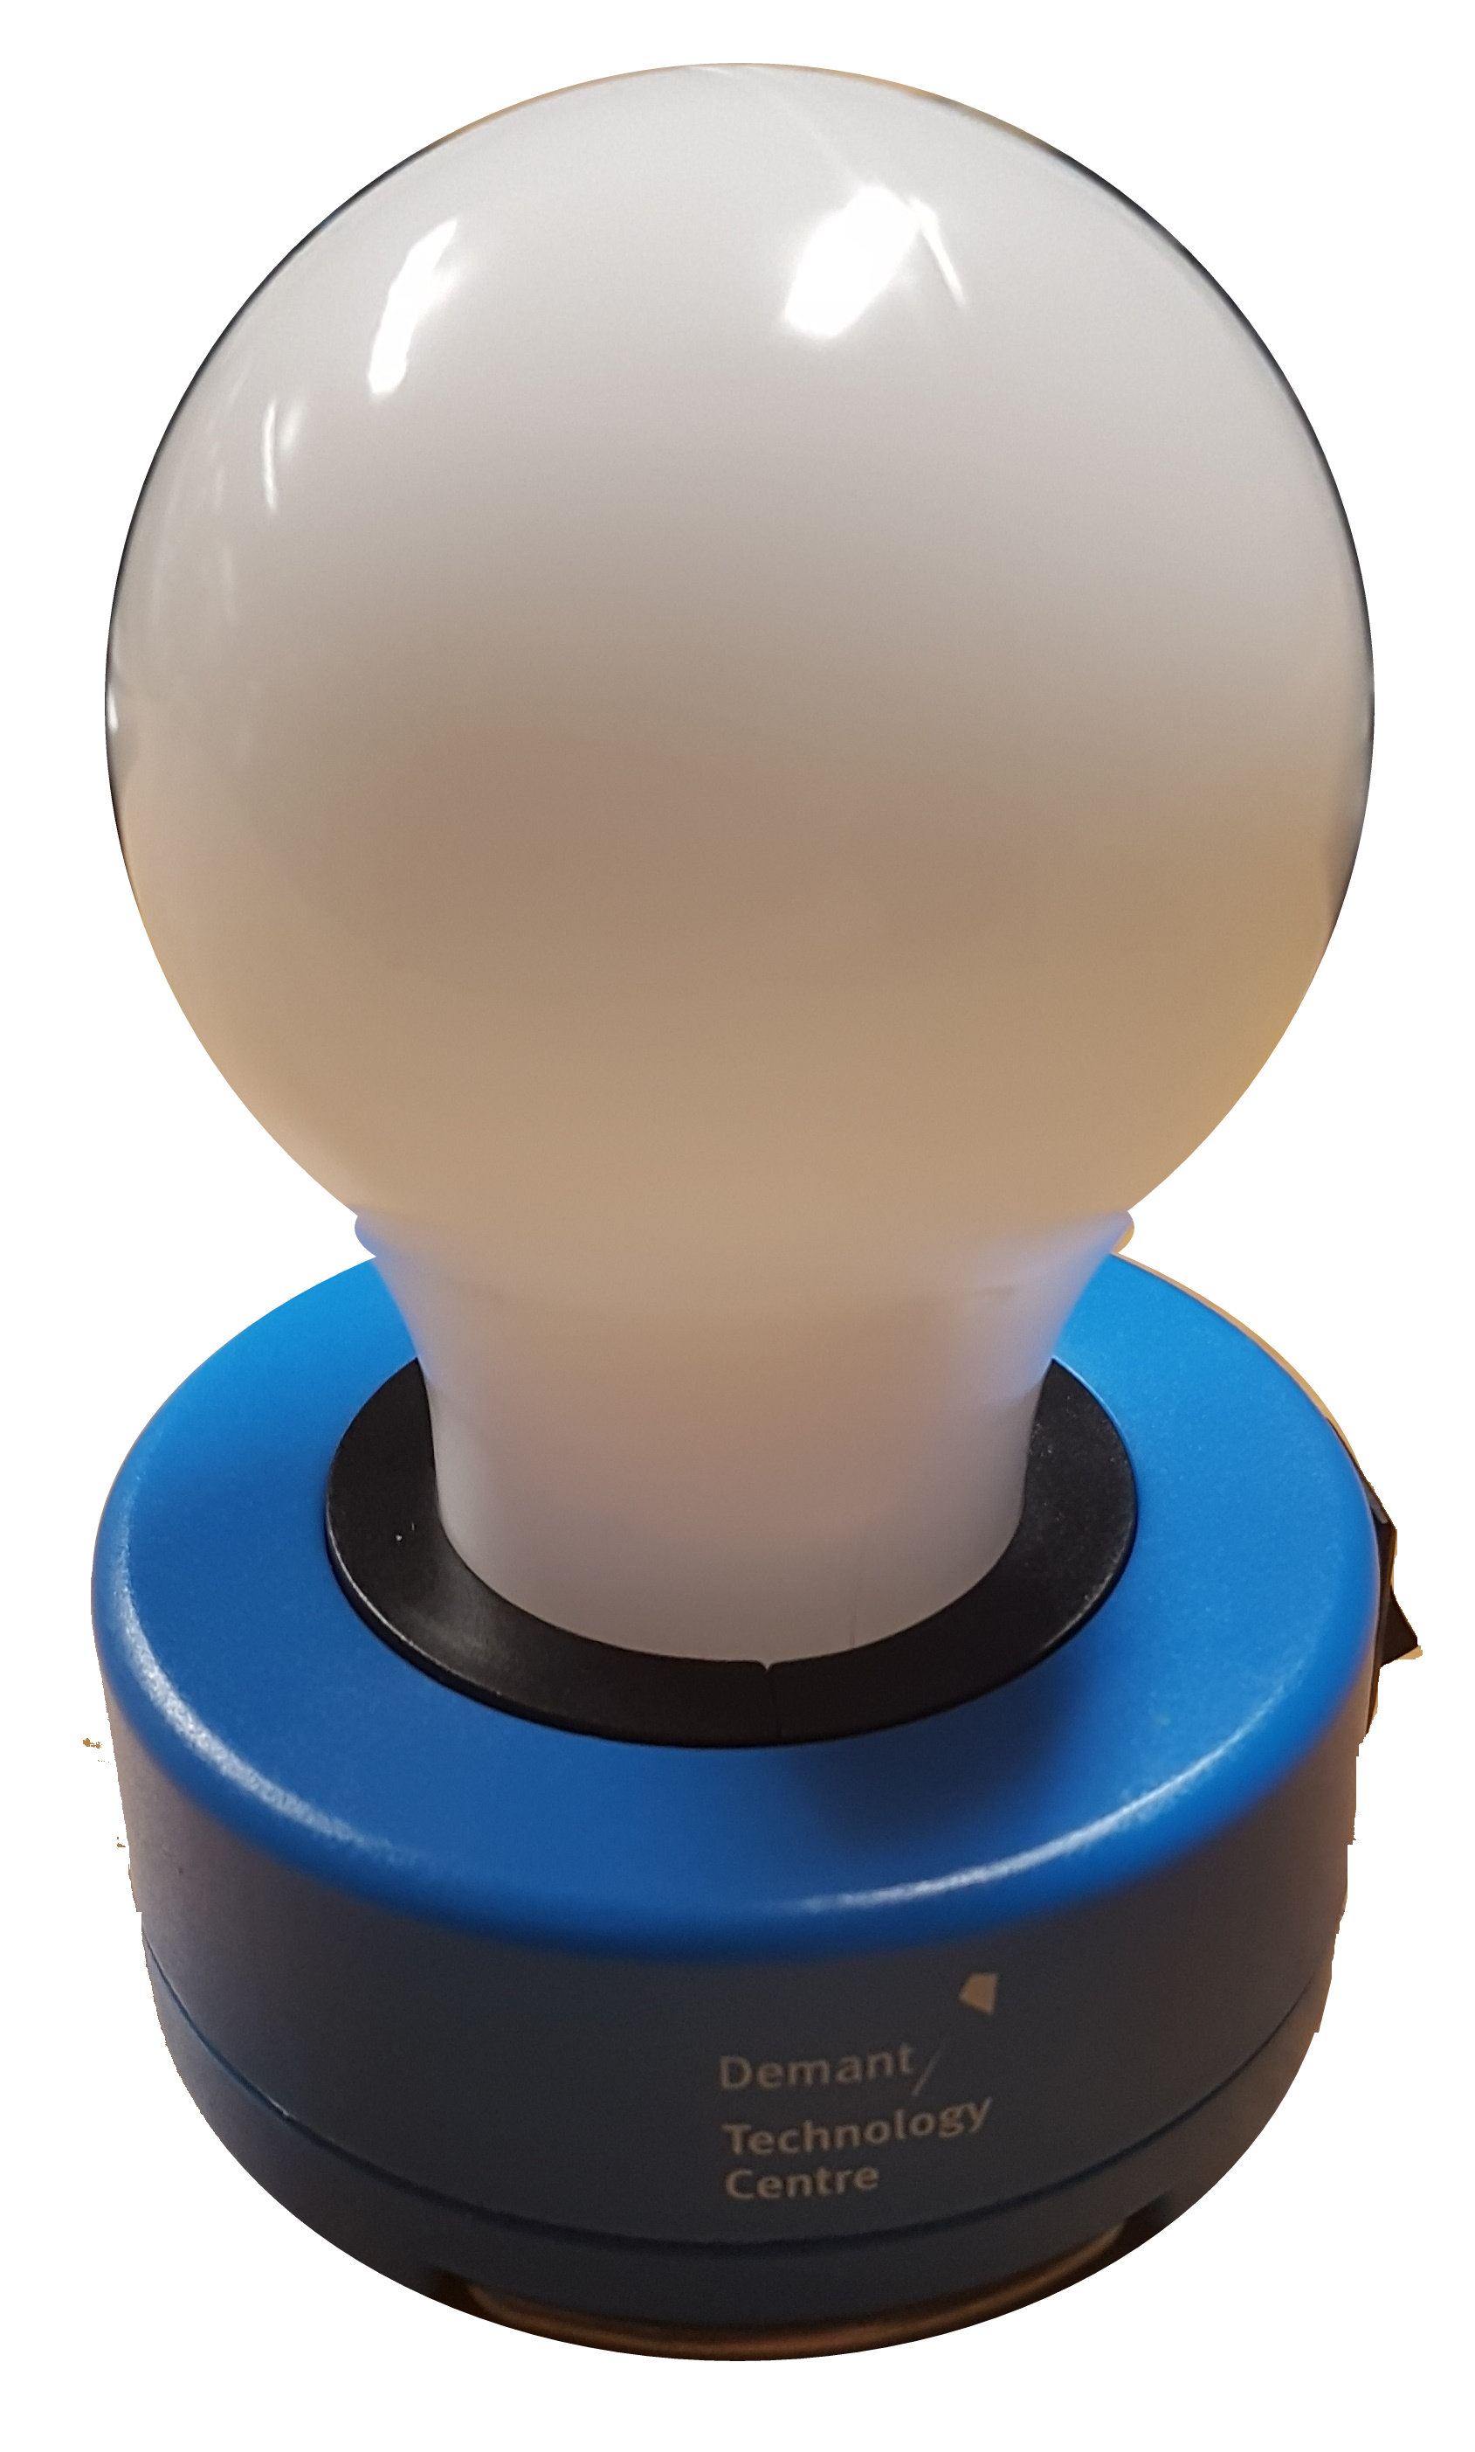
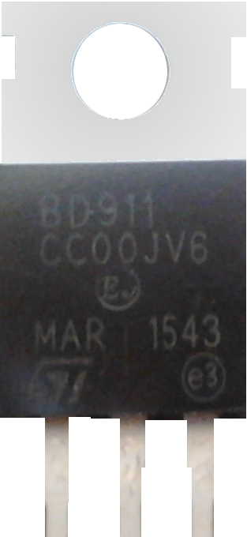
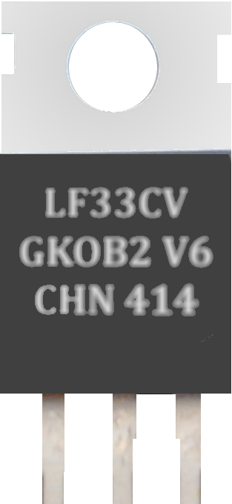
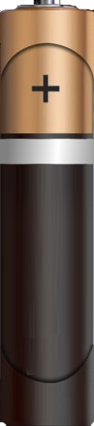
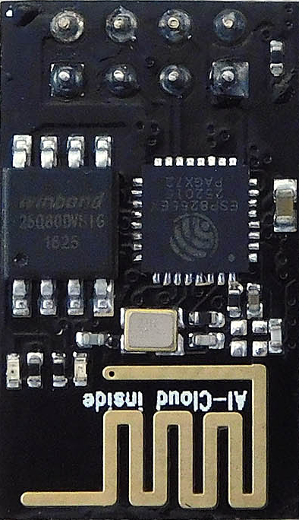
BONUS (3) Smart LAMP
B-C-E
I–G-O
GPIO2
4,7K Ω
4,7K Ω

Slide 46
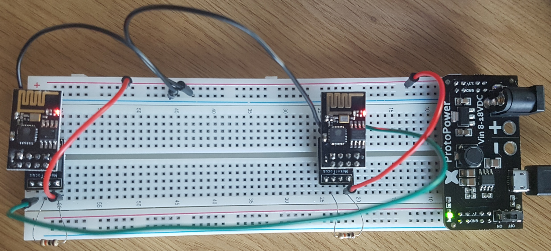
BONUS (4) WI-FI Sniffer

Slide 47
BONUS (4) WI-FI Sniffer
I–G-O
RX⬅TX
Forwarder
Sniffer

Slide 48
Summary
Node-Red™ and Mosquitto™ are really easy to use.
Both products have been on the market for long and they represent mature solutions.
To start you need to spend less than €30 plus your time.
Visual Studio Code™ and PlatformIO™ make an easy entry level.

Slide 49
References
Andreas Spiess https://www.youtube.com/channel/UCu7_D0o48KbfhpEohoP7YSQ
GreatScott! https://www.youtube.com/user/greatscottlab
Richard Wenner https://www.youtube.com/user/dicktonybo
bitluni's lab https://www.youtube.com/user/bitlunislab
Kevin Darrah https://www.youtube.com/user/kdarrah1234
Electronoobs https://www.youtube.com/channel/UCjiVhIvGmRZixSzupD0sS9Q
Ben Eater https://www.youtube.com/channel/UCS0N5baNlQWJCUrhCEo8WlA
AUTODESK ® TINKERCAD™ https://www.tinkercad.com/circuits

Slide 50

Where you can find me?
Web
https://lastboardingcall.pl
https://mrmatrix.net
GitHub
https://github.com/MariuszKrzanowski
Tweeter
@KrzanowskiM
Meetups
Warszawska Grupa .NET
Mariusz Krzanowski

Slide 51
Q & A

Slide 52
Thank you
☺

Slide 53
Where you can find me?
Web
https://lastboardingcall.pl
https://mrmatrix.net
GitHub
https://github.com/MariuszKrzanowski
Tweeter
@KrzanowskiM
Meetups
Warszawska Grupa .NET
Mariusz Krzanowski

